Slide 1
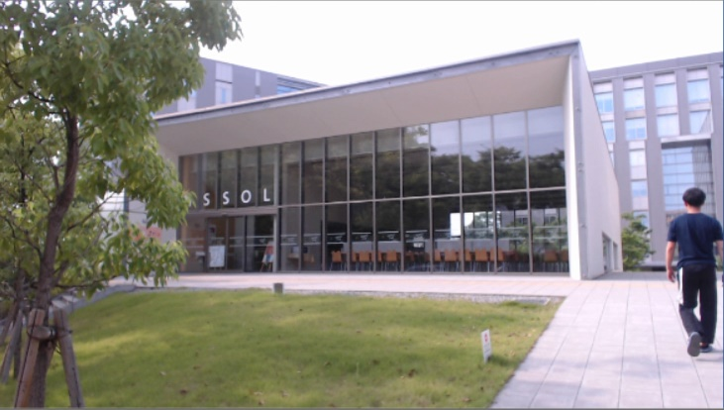
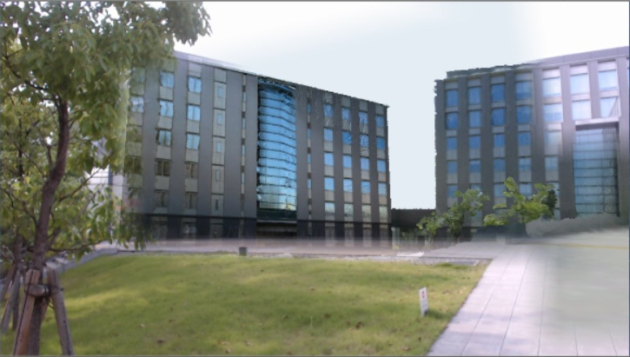
Predefined 3D mask models of immovable objects:
Structures for dismantlement and removal
Textured 3D models
for the background observation
Input image (Present)
Blurred mask image
Diminished Reality output
Real-time detection and masking of movable objects:
Humans, cars, and trains

Slide 2
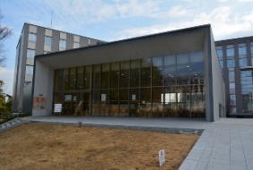
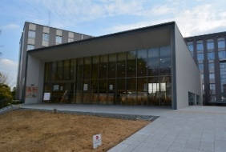
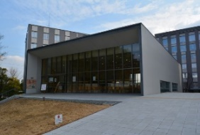
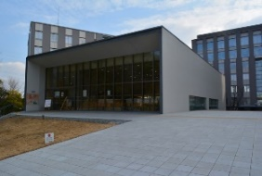
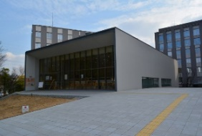
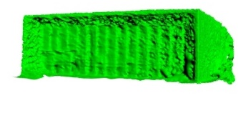
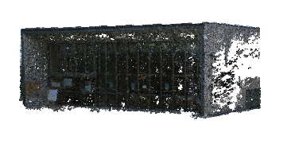
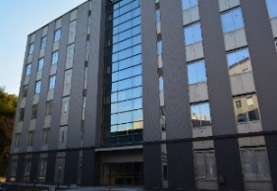
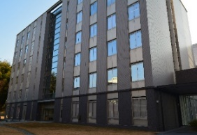
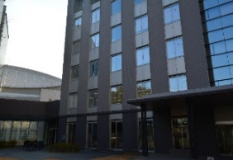
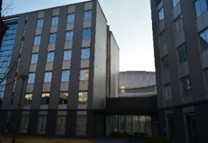
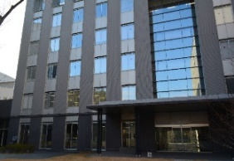
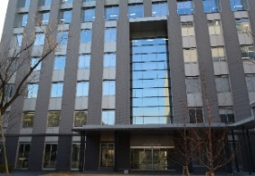
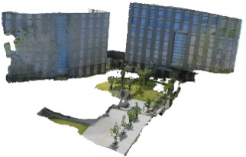
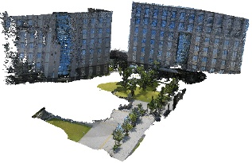
Exterior Structure (Dismantlement, Immovable objects)
Real-time detection
for movable objects
Preprocessing
Input image (Present)
Photos
3D Mask Model
3D Point Cloud Data
Mask image
Background
Preprocessing
Photos
Blurred mask image
3D Background
Model
3D Point Cloud Data
DR output

Slide 3
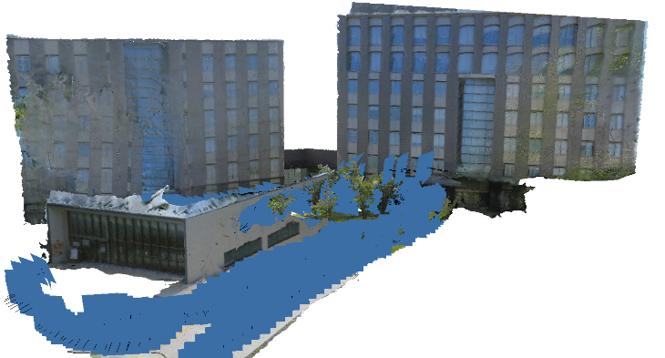
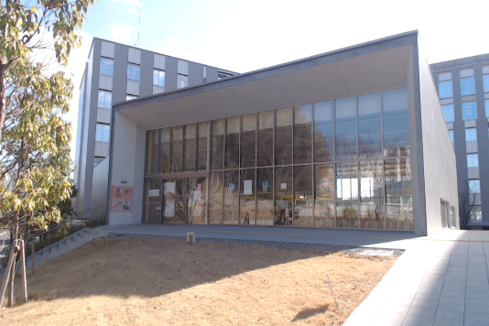
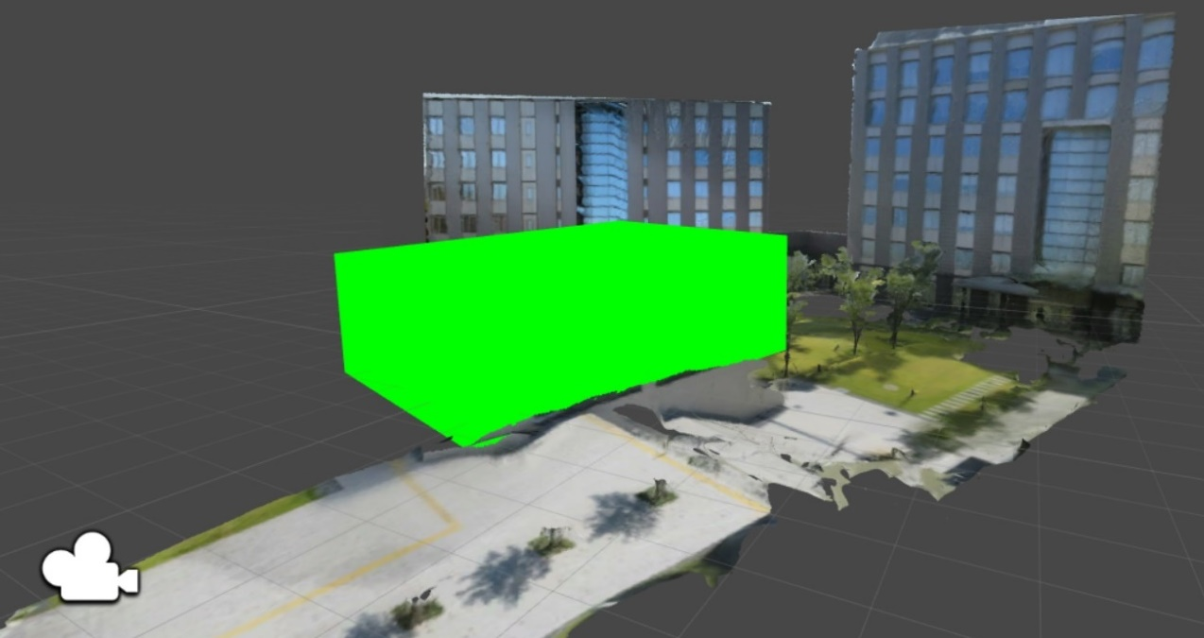
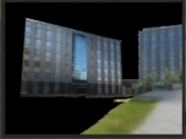
Photos for SfM
Reconstructed 3D model by SfM
(Blue rectangle: position and orientation of the each photo)
Photo for DR registration
(DR starts the position
in real world)
Position
Orientation
Background 3D model
Camera view of
mask
Mask 3D model
Camera component
Camera view of
background
Virtual world in game engine

Slide 4
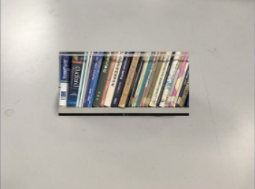
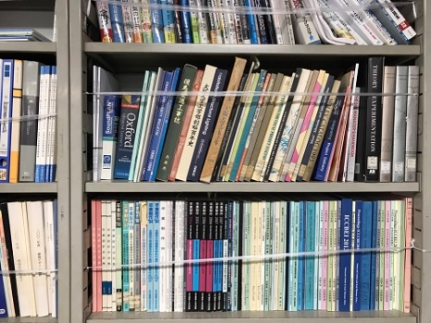
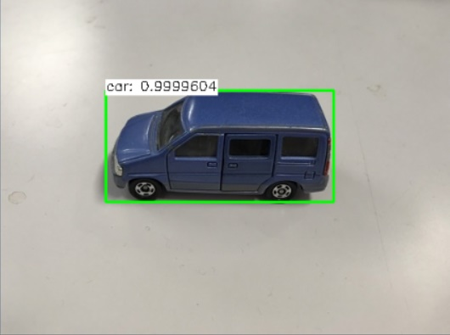
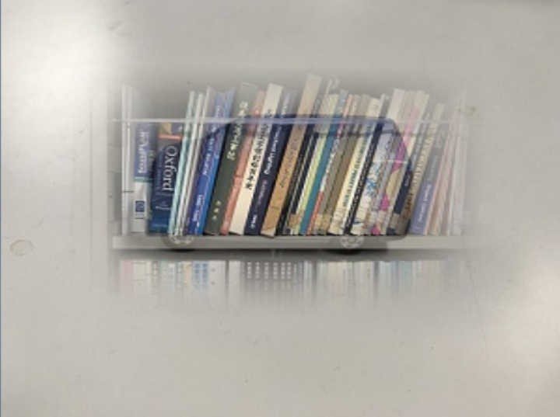
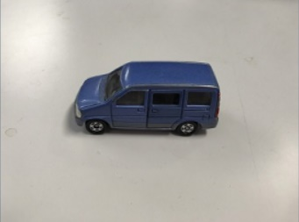
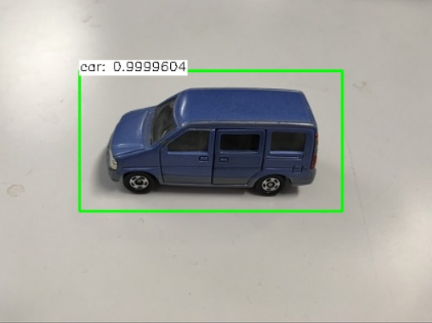
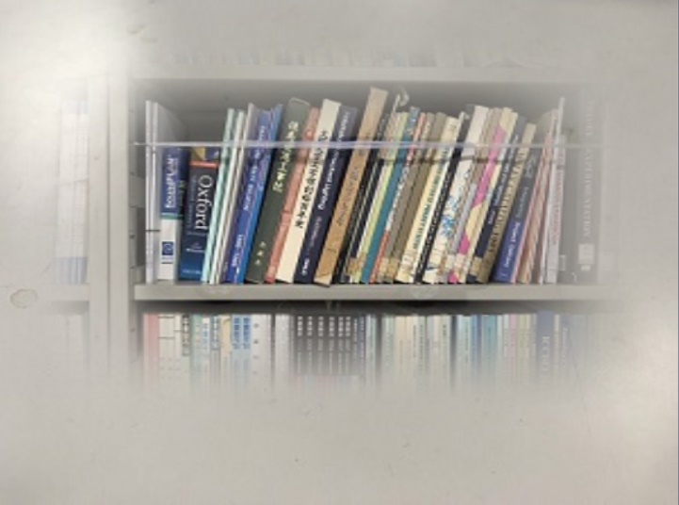
Mask image
DR output
Detection image
(Boundary box)
No blurred
Clear boundary
Background image
Original
Blurred
Inaccurate result
Input image
Proposed method
Larger
Blurred
Accurate result

Slide 5
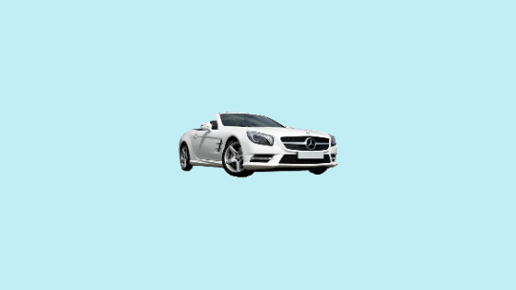
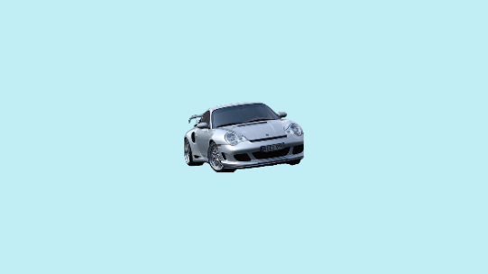
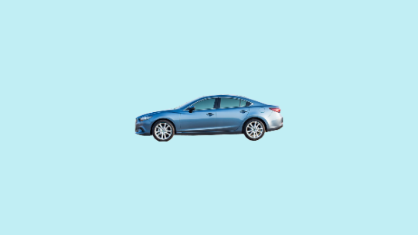
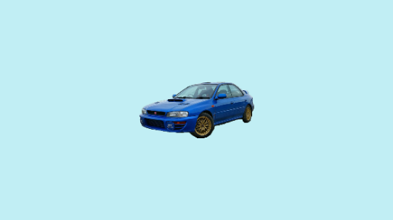
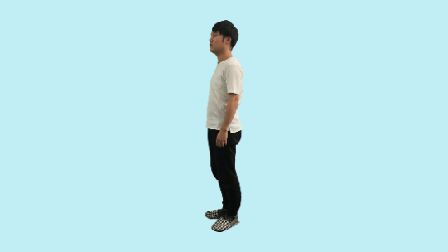
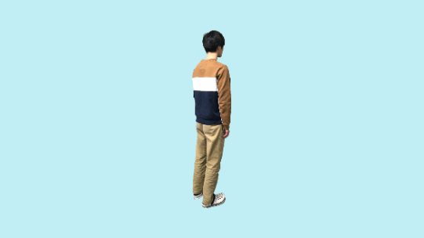
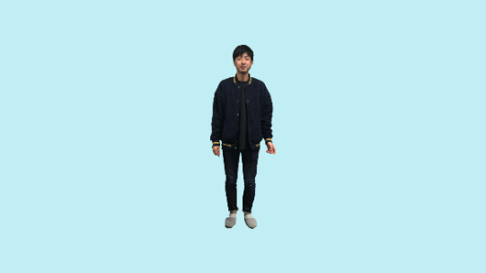
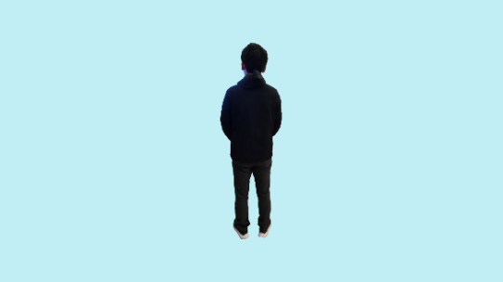

Slide 6
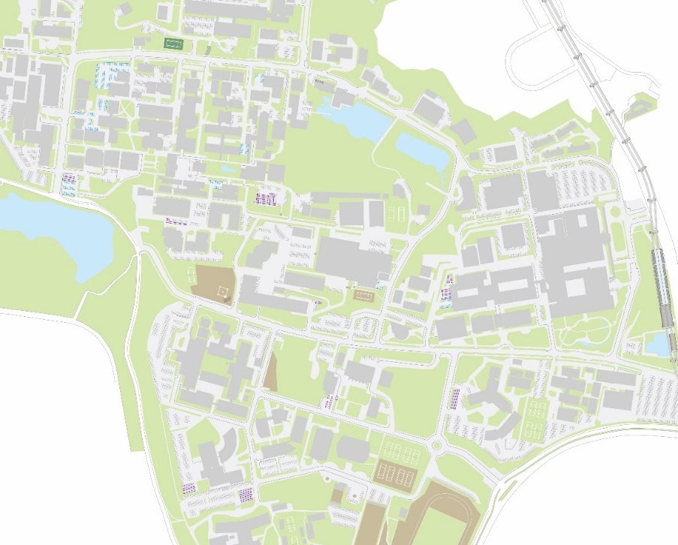
M3
S2
M4
U5
Osaka University
Suita campus
Starting position of
DR
20m

Slide 7
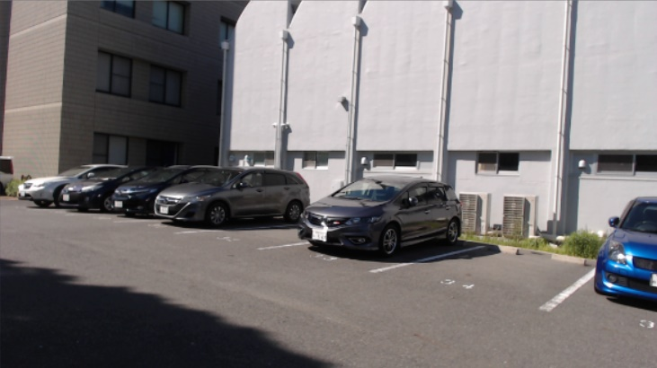
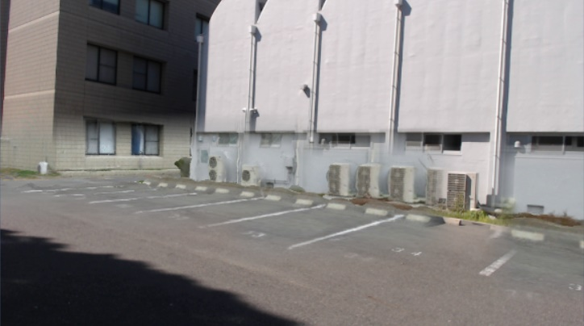
(a) Input image
(b) Blurred mask image
(c) DR image
(d) Removal area
(Red line: boundary between the input image and projected background)

Slide 8
Starting position of DR
Welfare centre
(Dismantlement)
C
Poplar Street
B
Information Science and Technology
Convention
Center
Osaka University
Suita campus
A
25m

Slide 9
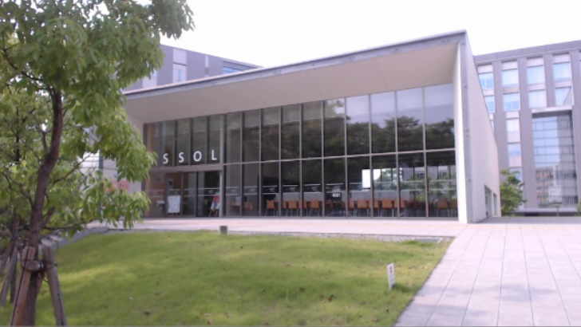
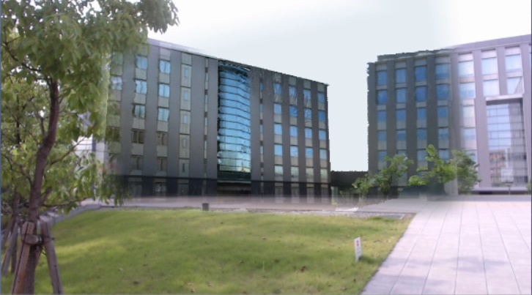
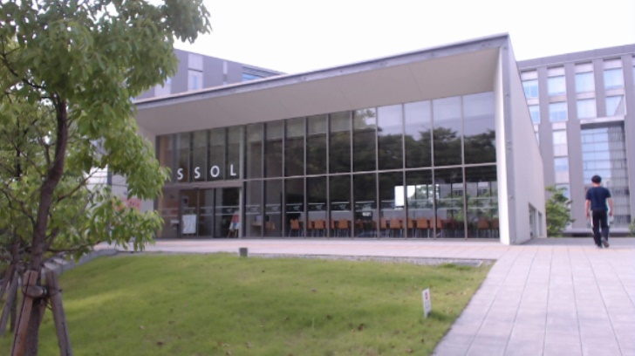
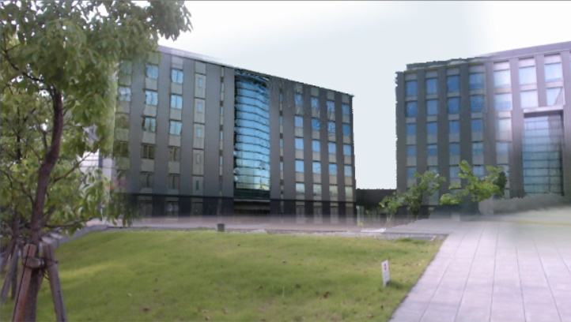
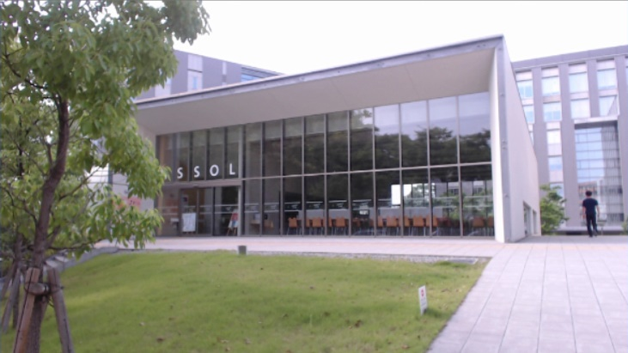
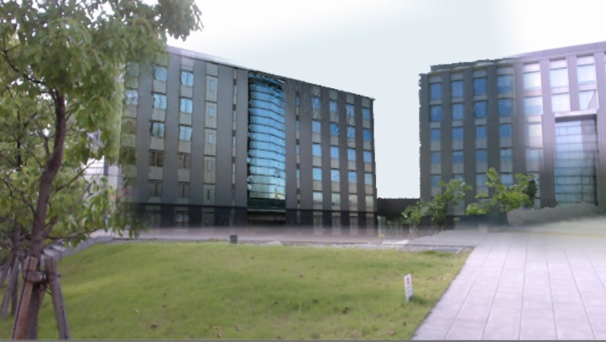
Input image
Mask image
DR image
Removal area
0 s
5 s
10 s
15 s

Slide 10
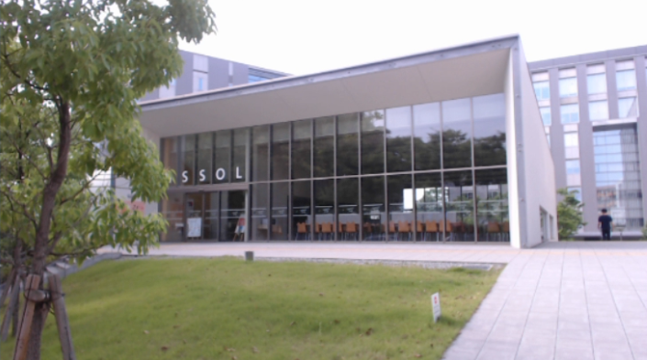
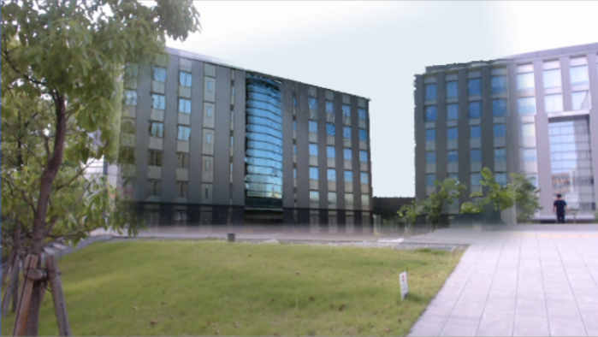
Input image
Mask image
DR image

Slide 11
– min – max –– mean

Slide 13
– min – max –– mean

Slide 15
Library, Software | Contents
Unity 2018.1.0f2 (64bit) | A game engine. Used for the system development platform.
OpenCV for Unity (ver. 2.3.2) | A computer vision plugin for Unity. Used for object detection with MobileNetSSD and creation of the mask image.
PhotoScan (ver. 1.2.3） | Photogrammetry software developed by Agisoft. Used for the restoration of 3D models by SfM.
^{2nd} draft after proofreading

Slide 16
Library, Software | Contents
Unity 2018.1.0f2 (64bit) | A game engine. Used for the system development platform.
OpenCV for Unity (ver. 2.3.2) | A computer vision plugin for Unity. Used for the object detection with MobileNetSSD and the creation of the mask image.
PhotoScan (ver. 1.2.3） | Photogrammetry software developed by Agisoft company. Used for the restoration of 3D models by SfM.
1st draft

Slide 17
Category | Product | Content | Appellation or Value
Laptop computer | mouse m-Book K686XN-M2SH2 | OS | Windows 10 Home 64-bit
 |  | CPU | Intel Core i7-7700HQ @ 2.80 GHz
 |  | RAM | 16.0 GB
 |  | GPU | GeForce MX150
Webcam | Logicool HD Pro Webcam C920 | Frame Rate (MAX) | 1080p @30 fps
 |  | FOV | 78°
^{2nd} draft after proofreading

Slide 18
Category | Product | Content | Appellation or Value
Laptop computer | mouse m-Book K686XN-M2SH2 | OS | Windows 10 Home 64bit
 |  | CPU | Intel Core i7-7700HQ @ 2.80GHz
 |  | RAM | 16.0GB
 |  | GPU | GeForce MX150
Webcam | Logicool HD Pro Webcam C920 | Frame Rate (MAX) | 1080p @30fps
 |  | FOV | 78°
1st draft

Slide 19
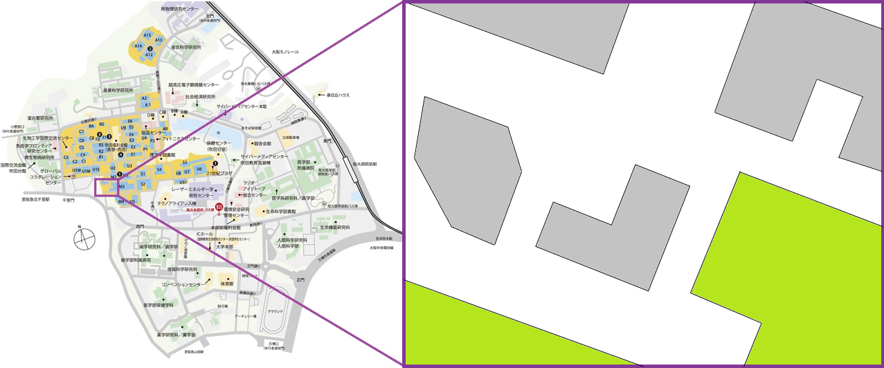
M3
S2
M4
U5
Anonymous University
Anonymous campus
Starting position for DR
20m

Slide 20
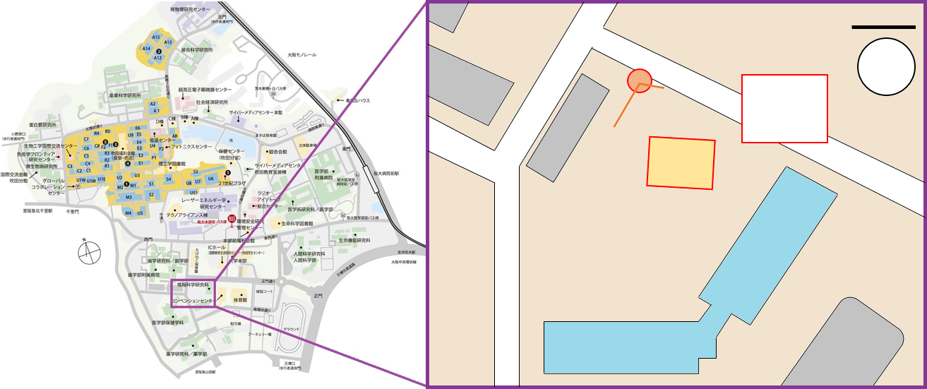
25m
Starting position for DR
Restaurant
2F, Welfare
Building
C
Poplar Street
(a)
B
Information Science and Technology
Anonymous University
Anonymous campus
Convention
Center
A
20m

Slide 21
Exterior Structure (Dismantlement)
Preprocessing
Object detection
Photos
Input image
Mask Model
3D Point Cloud Data
Mask image
Background
Preprocessing
Photos
Blurred mask image
Background Model
3D Point Cloud Data
DR image

Slide 22
depthwise convolution
pointwise convolution
Standard convolution
Depthwise separable convolution (MobileNets)

Slide 23
Extra freature layers
Detection
Non-Maximum Suppression
Input
image
Feature extracter

Slide 24
Photos for SfM
Reconstructed model with SfM
(blue rectangle: position and orientation of the photo)
Photo for DR registration
(DR start position in real world)
Position
Orientation
Background model
Camera view of mask
Mask model
Camera view of background
Camera component
Virtual world in game engine

Slide 25
Mask image
(Not blurred)
DR image
(Clear boundary)
Background image
Detection image
(Original)
Mask image
(Blurred)
DR image
(Edge transparent)
Input image
Detection image
(Larger)
Mask image
(Blurred)
DR image
(Proposed method)

Slide 26
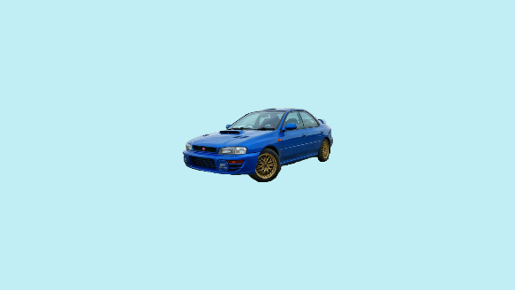

Slide 27
Existing Structure (Dismantlement)
Preprocessing
Resizing
Input Image
Object
Detection
Learned
Model
Photos
3D Point Cloud Data
Mask Model
Background
Preprocessing
Mask Image
Resizing
Photos
3D Point Cloud Data
Background Model
DR Image

